Slide 1
Architecture Design

Slide 2
Topics
Process
Foundational Architecture Design Principles and Techniques

Slide 3
Software Architecture Design Reference Model
Requirements:
Domain functions
Quality attributes
Use cases
Architecture Design Documentation
(ASRs/QAs)
Architecture
Drivers
Subset
Module
decomposition
design
Quality
Attribute
Scenarios
Design
decision
analysis
Architecture
Pattern
“Catalog”
Pattern and
design tactics
selection

Slide 4
Software Architecture Design
Architecture design is a systematic approach to making design decisions
Allocation of responsibilities | Allocation of functional and non-functional responsibilities into structural modules
Coordination model | Module interaction and system interfaces
Data model | Data abstractions and physical organization
Resource management | Shared resource(hard and soft) allocation and utilization
Architecture element mapping | Mapping of module abstractions to physical resources
Bind time decisions | Timing for variability – development, deployment, runtime
Technology choices | For hardware, software, tools
Checklist for QA Tactics Choices

Slide 5
Software Architecture Design
Starting with requirements …
Apply design best practices and knowledge
  Patterns– structure scaffolding based on the ASR’s; select or create
  Design tactics – proven design solutions in problem context
  Foundational design principles and techniques at the module level
Analyze design decisions and refine – requirements satisfied, QA tradeoffs addressed?
  Quantitative and qualitative analysis
Document the structures in views with supplemental information
  Module, component-connector, allocation

Slide 6
Attribute Driven Design
Requirements:
Domain functions
Quality attributes
Use cases
Architecture
Design Documentation
Architecture
Drivers
Subset
Module
decomposition
design
Quality
Attribute
Scenarios
Design
decision
analysis
Architecture
Pattern
“Catalog”
Pattern and
design tactics
selection

Slide 7
Attribute Driven Design Strategy
Important quality attributes affect the whole system
Therefore design begins with the whole system
  Each element may inherit all or part of the quality attribute requirements from the whole
Design to satisfy all architecturally significant requirements – one or more at a time
  Quality attributes (scenarios)
  Constraints and other ASR’s– e.g., legacy systems
  Functional requirements (use cases)

Slide 8
Attribute Driven Design Strategy (cont)
Initial design is generated from some combination of ….
  Existing systems and frameworks
  Architecture patterns and tactics selected to satisfy quality attributes
  Domain functions (use cases) allocated to modules provided by the pattern and associated tactics
Test the initial design – does it satisfy requirements?
  Use analysis techniques ( future topic) and checklists of ASR requirements

Slide 9
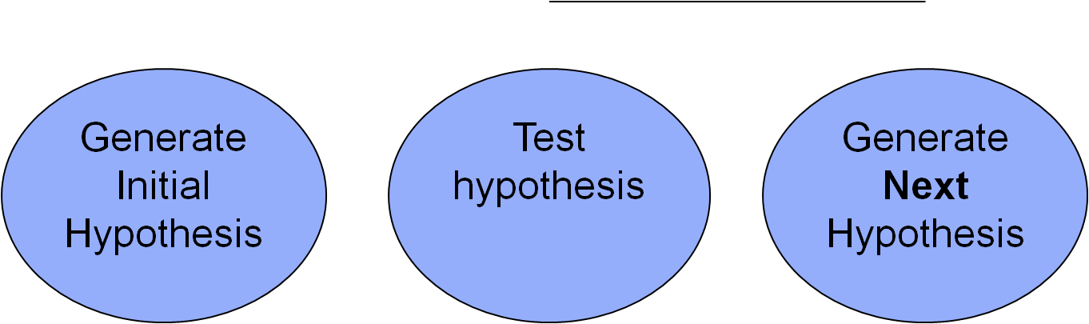
Attribute Driven Design Strategy (cont)
Refine initial design by addressing missing requirements and applying other design tactics
Recursive decomposition - for some subsystem of the system…
  Repeat the process
When do you declare victory?
  All ASRs are satisfied
  Out of time and money – construction will refine

Slide 10
Attribute Driven Design “Strategy”
A
Apps
Views
B
Publish-Subscribe
Allocate Functions
Controller
Broker
C
Microservices
Models
Map-Reduce
Pipeline

Slide 11
Function Driven Design
Requirements:
Domain functions
Quality attributes
Use cases
Architecture
Design Documentation
Architecture
Drivers
Subset
Module
decomposition
design
Quality
Attribute
Scenarios
Design
decision
analysis
Architecture
Pattern
“Catalog”
Pattern and
design tactics
selection

Slide 12
Functionality-Based Architectural Design
Starting from functional requirements …
Define system context
Identify subsystems (first order functional abstractions)
  Top down, step wise refinement
  Is a bottom up approach ever advised?
Decompose into modules (second order functional abstractions)
Describe in system views
Output artifact is the application architecture
Abstraction
Detail

Slide 13
Estimate Quality Attributes
Evaluate the quality attributes – will the architecture fulfill the quality attribute requirements?
How to determine – actual values can’t be measured …
  “Formal” architecture analysis techniques
    Architecture Tradeoff Analysis Method (ATAM) (discussed soon)
  Simulation – build a skeleton of the entire system, or prototype parts to execute scenarios
  Quantitative (mathematical) modeling of scenarios; e.g., queuing network theory
  Qualitative experience-based assessment
In practice use more
than one method

Slide 14
Architecture Transformation
Compare evaluation estimates to requirements
If requirements not satisfied (likely), the architecture (or its context) must be changed
Apply two or more architecture transformation methods:
  Impose architectural patterns
  Apply design tactics
  Convert quality requirements to functionality to extend the architecture (e.g., exception handling)
  Distribute quality requirements to subsystems
Reevaluate the transformed architecture against functional and quality requirements

Slide 15
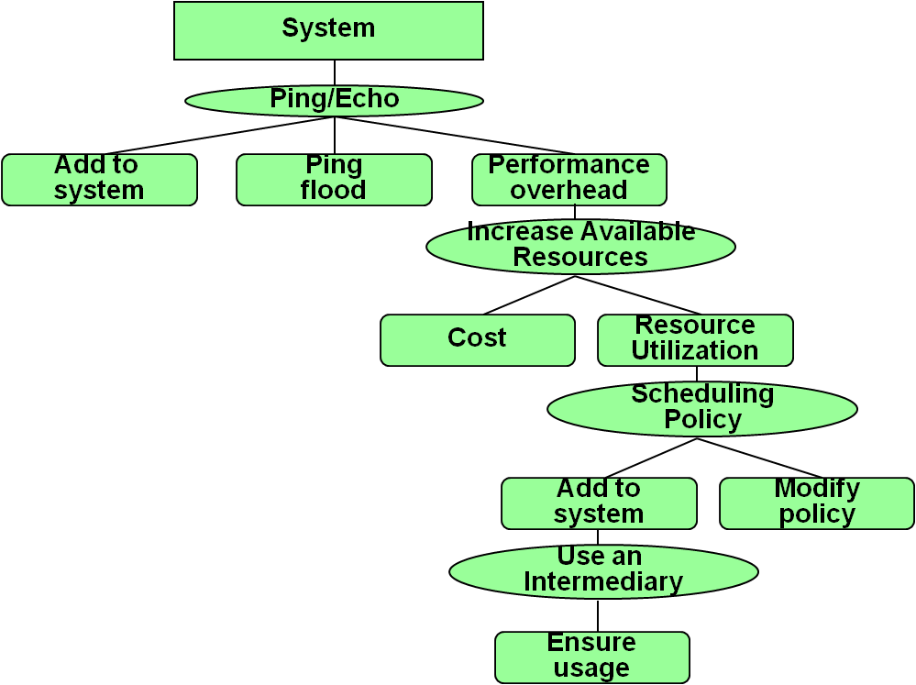
Issues
Quality attributes can be in conflict – QA tradeoffs
  Examples?
Complexity – relatively simple functional architectural designs may blow up in complexity to support quality attributes
  Lose conceptual understanding
Quality assessment estimates are estimates and may lead to the wrong decisions (GIGO)
  The only real validation is the final system

Slide 16
Foundational Architecture Design Techniques
Fundamental Principles
Unit Operations

Slide 17
Some Historical Perspective
In the 60’s programmers started to develop good design practices out of necessity
In the 70’s these were more formally captured in papers by people like Fred Brooks, Edsger Dijkstra, and David Parnas
In the 80’s these practices were embodied in object oriented design
These design principles and unit operations can and should be applied to software architecture design
Component X
Component Y

Slide 18
Fundamental Principles and Techniques of Software Construction
Abstraction | Define conceptual boundaries
Separation of Concerns | Separate different or unrelated responsibilities
Modularization | Packaging of entities that form the logical structure of a system - modules
Information Hiding | Conceal module design details from its clients
Encapsulation | Group the elements of an abstraction that constitute its structure and behavior
Coupling and Cohesion | Inter- and intra- module dependency strength
Sufficiency, Completeness and Primitiveness | Satisfy minimum and necessary requirements as atomic operations
Separation of Policy and Implementation | Separation of context sensitive knowledge and rules from algorithmic implementation
Separation of Interface and Implementation | Separation of the declaration of functionality from its realization
Single Point of Reference | Declare and define a module only once to avoid inconsistency

Slide 19
Software Partitioning Strategies (e.g.)(Separation of Concerns)
Isolate:
  Hardware dependencies
  Time critical components
  Configuration data
  External interfaces
Separate:
  Logically cohesive domain functionality
  Human computer interface from domain model
  Main functions from utility functions (cross cutting concerns)

Slide 20
Additional Notes
Architecture concerns at a module level …
Most principles and techniques are closely related – complementary
Some principles contradictory
Integration and dependencies

Slide 21
Modularity and Software Cost
Cost to integrate
Region of minimum cost
Cost of Effort
Cost/module
Number of Modules

Slide 22
Software Changeability and
Dependency Management
The stable dependencies principle (SDP):
  “Depend in the direction of stability”; modules should only depend on modules that are more stable than it is
Acyclic Dependencies Principle
  “Dependency structure for released components must be a directed acyclic graph”; no cycles in the dependency structure
Interface Segregation Principle
  Clients should not be forced to implement interfaces they don’t use

Slide 23
Integration Strategies
How will various parts of the system communicate?
  E.g., COTS or legacy systems, major internal subsystems
  Build time versus run time binding decisions
Data-only integration (lower level of abstraction)
  Loose coupling through data exchange only in suitable formats
  Downside – user may be involved
Executable integration (higher level of abstraction)
  A stand-alone executable component is used to perform a specific function in the system for data interoperability

Slide 24
Unit Operations
Basic (primitive) operations applied to architecture design
Unit operations are the steps that one applies to derive patterns
Examples (object design derivation)
  Part-whole decomposition
  Is-a decomposition
  Replication
  Abstraction
  Compression
  Resource sharing

Slide 25
Unit Operations
Part-whole decomposition
Is-a decomposition
Replication
Abstraction
Compression (Consolidation)
Resource Sharing

Slide 26
Software Architecture Design Example
Using Attribute Driven Design

Slide 27
Garage Door Example
Design a product line architecture for a garage door opener integrated with a home information system
  Raise/lower door via switch, remote, home info system
  Problem diagnosis from home information system
Diagnostics
Alerts
Home Info Sys
Garage Door Opener
Sensor/
Actuator
Control
Control
Control
Remote

Slide 28
Step 1: Choose a System Element to Design
For new (green field) systems it is the whole system
For legacy, what is being added
After the first iteration what comes next, element breadth or depth?
  Depth if technology risk or resourcing concerns
Garage door opener is the system

Slide 29
Step 2: Identify the ASRs
(Architecturally Significant Requirements)
Start with quality scenarios
  Device and controls differ for various products in product line
  Product processors differ
  Garage door descent must stop within 0.1 second after obstacle detection
  Access to opener from home info system for control and diagnostics with proprietary protocol

Slide 30
Step 2: Identify the ASRs (cont)
ASRs are a combination of functional requirements, constraints and quality attributes
Prioritize ASRs and select those that will “drive“ the architecture design
Garage door system:
  Real-time performance
  Modifiability to support the product line
  Interoperability for on-line control and diagnostics

Slide 31
Step 3: Generate a Design Solution
For the Chosen Element
Goal: establish an overall architecture design that satisfies architectural drivers
For each ASR for this element choose a design solution …
The patterns, tactics, design principles to achieve quality attributes
Watch for QA design tradeoffs between tactics
It’s possible the domain problem may call for a “custom” architecture pattern

Slide 32
Step 3: Generate a Design Solution (cont)
Performance
  Concerned with critical computational performance scheduling and efficiency
  Need tactics to deal with the control of resource demand and resource management
  Choose “increase resource efficiency” and “schedule resources”
  Solution - separate critical and non-critical performance computation

Slide 33
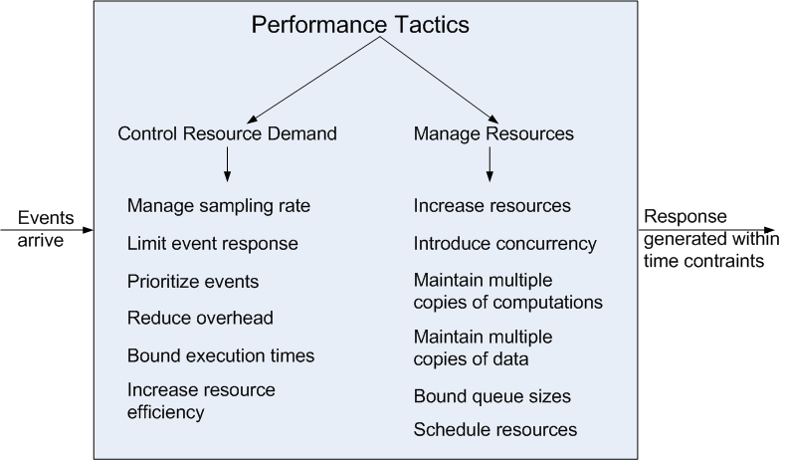
Performance Tactics

Slide 34
Step 3: Generate a Design Solution (cont)
Modifiability
  Primarily concerned with changes at build time, not runtime
  Need tactics to support separation of responsibilities to localize changes
    Increase cohesion, reduce coupling
  Choose “increase semantic coherence”, “encapsulation”, and “abstract common services” as our tactics
  Solution - separate responsibilities dealing with the user interface, communication, and sensors into their own modules

Slide 35
Modifiability Tactics

Slide 36
Pattern for Garage Door Opener
User Interface
Non-Performance-
Critical Computation
Performance-Critical
Computation
Virtual
Machine
Schedule that
Guarantees Deadlines

Slide 37
Step 4: Validate Design and Refine Requirements
Test the element design for requirements satisfaction
Requirements satisfied | Done, no more refinement
Requirements not fully satisfied | Defer to the next iteration Delegate or distribute requirement satisfaction to sub-module elements
Requirements cannot be satisfied with this design | Revisit the design - backtrack Refine or push back on the requirement

Slide 38
Step 4: Validate Design and Refine Requirements
(cont)
ASRs Not Met | Action
Quality attribute | Apply tactics to address tradeoff or downside
Functional responsibility | Add responsibilities to existing module Create new module
Constraint | Modify the design Relax the constraint
Note: Previous designs become a constraint

Slide 39
Step 5: Repeat Until all ASRs Have Been Satisfied
If all ASR’s satisfied, done – a workable architecture
  Or elaborated sufficiently for construction
  (or you run out of time and money)
Otherwise …
Repeat step 1 - choose the next (sub)element(s) to design
Repeat steps 2-4
As necessary refine use cases and QA scenarios as ASRs for the next design iteration

Slide 40
Are the ASR’s Satisfied?
Or is the Design Sufficient?
Device and controls differ for various products in product line
Product processors differ
Garage door descent must stop within 0.1 second after obstacle detection
Access to opener from home info system for control and diagnostics with proprietary protocol

Slide 41
Next Iteration Decomposition
Define sub-modules, assign functionality
Two types of virtual machine – sensors/actuators and communications modules
Non-performance critical functional modules – diagnostics and normal raising/lowering the door modules
Obstacle detection and halting the door functions assigned to performance critical module
Connections

Slide 42
Next Iteration Design Decomposition
User Interface
Diagnose
Raising/Lowering
Door
Obstacle
Detection
Communication
Virtual Machine
Sensor/Actuator
Virtual Machine
Scheduler that
Guarantees
Deadlines

Slide 43
Lets design the HC system
Users Register
Users select Health plan
- Online
- By Mail
- By phone

